Slide 1
Day 33
Range Sensor Models

Slide 2
Beam Models of Range Finders
given the map and the robot’s location, find the probability density that the range finder detects an object at a distance
along a beam
the k is here because range sensors
typically return many measurements
at one time; e.g., the sensor might
return a full 360 degree scan made
up of K measurements at once

Slide 3
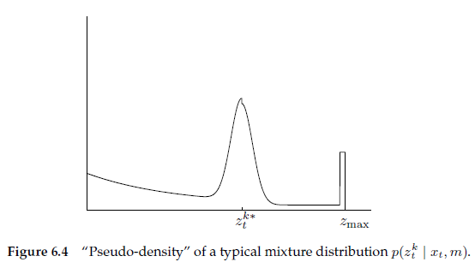
Beam Models of Range Finders
most range finders have a minimum and maximum range
we seek a model that can represent
  the correct range measurement with noise
  unexpected obstacles
  failures
  random measurements
1
3
2

Slide 4
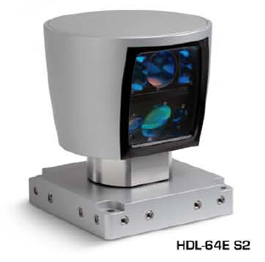
Beam Models of Range Finders
beam-based model is computationally expensive
  each measurement requires a ray intersection with the map to compute
Velodyne HDL-64E S2
>1.3 million measurements per second

Slide 5
Beam Models of Range Finders
computational expense can be reduced by precomputing
  decompose state space into a 3D grid
    much like histogram filter
  for each grid location compute and store
much faster than ray casting but…

Slide 6
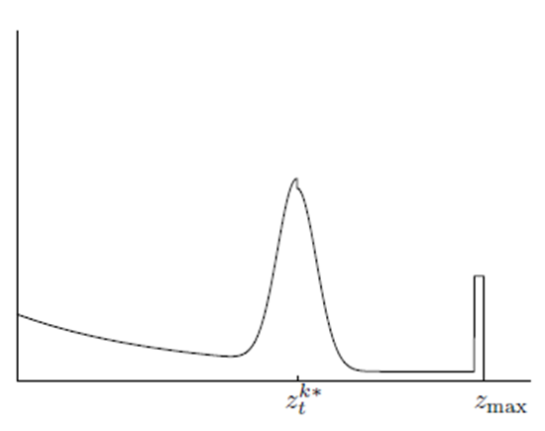
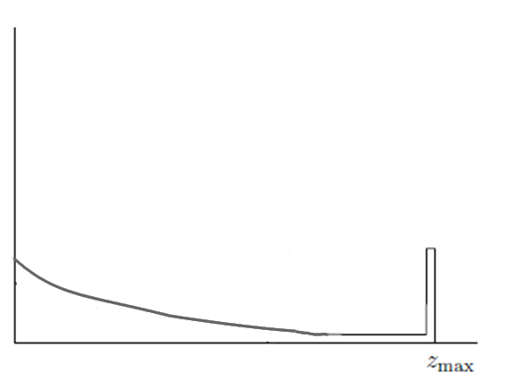
Beam Models of Range Finders
changes abruptly for small changes in
  especially true for small changes in θ
map obstacle detected for robot bearing θ
map obstacle missed for robot bearing θ+d θ

Slide 7
Likelihood Fields for Range Finders
an alternative model called likelihood fields overcomes the limitations of the beam model
  but is not physically meaningful
recall that a range measurement is a distance measured relative to the robot
  can we transform into a point in the map?

Slide 8
Likelihood Fields for Range Finders
want this in {0}
measured in {1}
measured in {0}

Slide 9
Likelihood Fields for Range Finders

Slide 10
Likelihood Fields for Range Finders
similar to the beam model, we assume 3 types of sources of noise and uncertainty
correct measurement with noise
failures
random measurements

Slide 11
Likelihood Fields for Range Finders
Correct Measurement with Noise
once we have we find the point on an obstacle in the map that is nearest to and compute the distance d between those two points
this measurement is modeled as a zero-mean Gaussian with variance

Slide 12
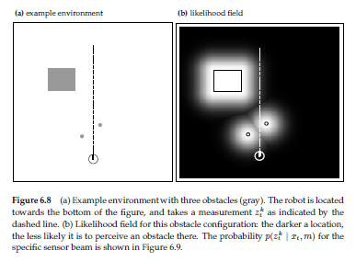
Likelihood Fields for Range Finders

Slide 13
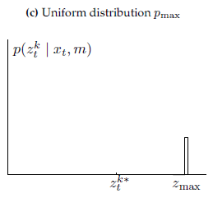
Beam Models of Range Finders
Failures
range finders can fail to sense an obstacle in which case most sensors return
modeled as a point mass distribution centered at

Slide 14
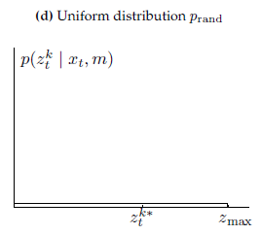
Beam Models of Range Finders
Random Measurements
unexplainable measurements are modeled as a uniform distribution over the range [0, ]

Slide 15
Beam Models of Range Finders
the complete model is a weighted sum of the previous three densities with weights

Slide 16
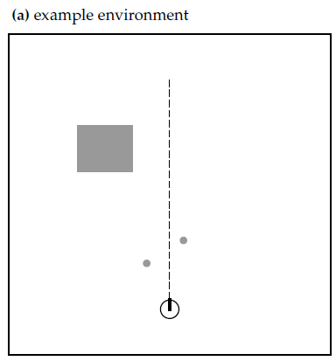
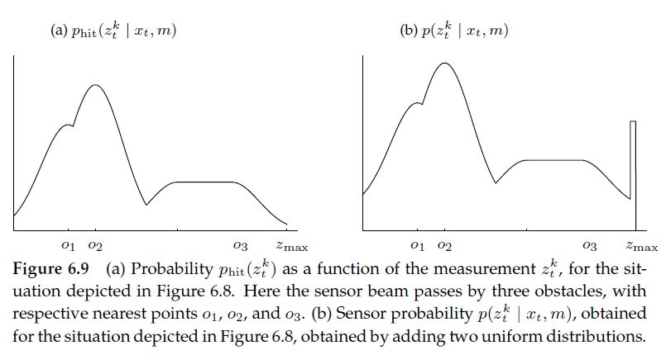
Beam Models of Range Finders

